Slide 1
TECHNOLOGY
SESSION 7
I/O

Slide 2
OBJECTIVES
After this session, you should be able to...
  Explain the basic I/O hardware concepts.
  Explain the basic I/O-related OS facilities.
  Optimize the performance of Java-based program I/O
  Apply non-blocking and asynchronous I/O
  Determine when non-blocking I/O is appropriate.

Slide 3
I/O DEVICES
There are several different kinds of I/O device.
...there are also several different schemes to categorize them by.
Stallings defines three basic types:
  Human-readable: Devices for interaction with a human user. Mouse, keyboard, display, etc.
  Machine-readable: Devices for interaction with electronic equipment. USB keys, disks, etc.
  Communication: Devices for interaction with other computer systems. Ethernet, Wifi etc.

Slide 4
I/O DEVICES
Another very coarse-grained classification is used in the Linux kernel:
  Character devices: Devices that transfer data as streams of bytes.
  Block devices: Devices that transfer data as compound blocks.
In this scheme, disks are block devices, and most other devices are character devices.

Slide 5
I/O DEVICES
There are many other criteria for classifying and understanding I/O devices.
  Data rate
  Application
  Unit of transfer
  Data representation
  Control complexity
  Error conditions

Slide 6
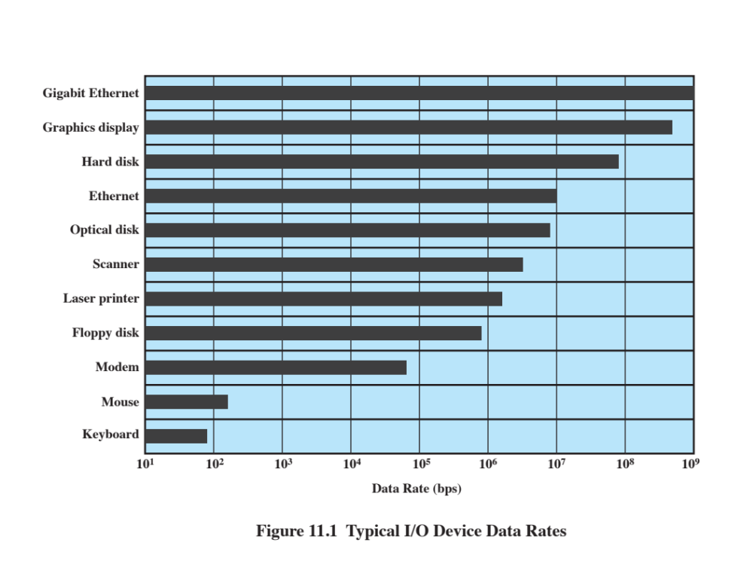
I/O DEVICES

Slide 7
THE I/O FUNCTION
As we saw earlier, there are several different ways I/O devices can interact with the rest of the system.
Programmed I/O
  The processor issues an I/O request, then busy-waits until it receives a response
Interrupt-driven I/O
  The processor issues a request, then:
  (for blocking I/O) executes some OS code, blocks the current process
  (for non-blocking I/O) executes more user code

Slide 8
THE I/O FUNCTION
I/O also differs in the technique used to transfer data to and from memory.
Direct Memory Access (DMA) is used to decouple processor and I/O device even further; the processor only gets involved at the very beginning and end.
In general, decoupling the processor and I/O device is good; there are orders of magnitude speed differentials between them.

Slide 9
EVOLUTION OF THE I/O FUNCTION
1. Processor directly controls a device.
2. A dedicated controller is added.
3. The controller uses interrupts.
4. The device gets control of memory via DMA.
5. The device gets a dedicated instruction set.
6. The device gets its own memory, effectively becoming a computer in its own right.

Slide 10
BUFFERING
It is often inconvenient or inefficient to work with I/O devices directly. In such cases, buffering can be used.
Buffering allows further decoupling, using software: Input can be fetched before it is needed, and output can be transferred after the request is made.
Apart from OS-level buffering, application-level buffering is also possible. We’ll see a few Java examples later.

Slide 11
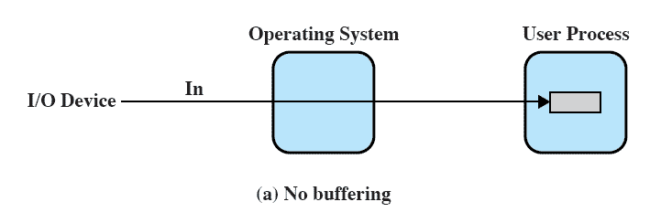
UNBUFFERED I/O
The system accesses an I/O device when requested.

Slide 12
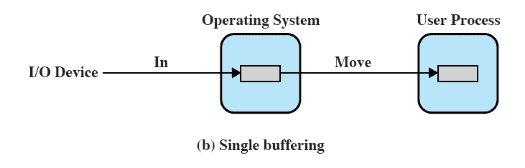
SINGLE-BUFFER I/O
The system maintains a single buffer in RAM for I/O requests.

Slide 13
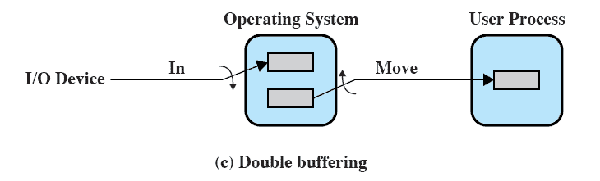
DOUBLE-BUFFERED I/O
Two buffers are used, such that one can be transferred to while the other is being emptied.
Allows for “smoothing”; commonly used in graphics.

Slide 14
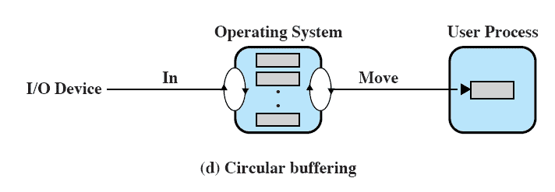
CIRCULAR-BUFFERED I/O
Multiple buffers, allowing the device or system to get a fixed number of accesses “ahead” of the other.

Slide 15
FILES
Files are implemented in the OS, by the file system.
The purpose of files is to package data into discrete collections that have some semantic meaning to users or programs.
There are many different file systems:
  Windows: FAT16, FAT32, NTFS, ReFS…
  Linux: ext3, ext4, ReiserFS, XFS, btrfs…
  MacOS X: HFS+, APFS, ...

Slide 16
FILES
Some facilities are common across all modern filesystems:
  Hierarchical data organization in directories (“folders”).
  Permission systems or Access Control Lists
  User and group data (usually used with permissions)
    Example: rwxr-x---- in UNIX
Filesystems differ widely in performance characteristics – some (eg. reiserfs) are good for many small files, others (eg. XFS) are opposite.

Slide 17
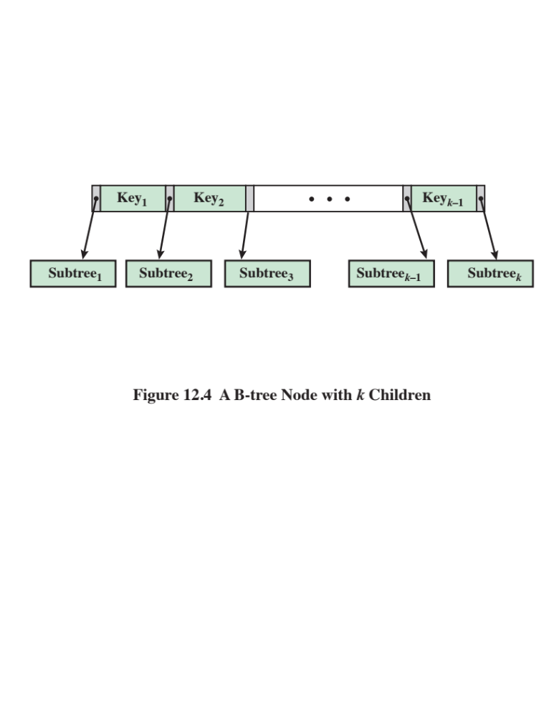
FILES
File systems are commonly implemented using B-Trees, a data structure that allows for very fast data retrieval.

Slide 18
I/O IN JAVA: CLASSIC IO
Java implements basic I/O in the java.io library.
The core I/O library implements an I/O scheme based on the following:
  Every I/O method calls into a native OS function.
  I/O methods are blocking.
  I/O methods are unbuffered by default.
  Files are either character streams or byte streams.
    Unicode characters may be multibyte!

Slide 19
I/O IN JAVA: CLASSIC IO
Example 1: Line count
public int lineCount(String path){
FileInputStream fis = new FileInputStream(path);
int cnt = 0;
int b;
while ((b = fis.read()) != -1) {
if (b == '\n') cnt++;
}
fis.close();
return cnt;
}

Slide 20
I/O IN JAVA: CLASSIC IO
Although this example is straightforward, it’s not particularly efficient – at least unless the underlying OS makes some very smart I/O decisions.
In general, tuning I/O performance with java.io reduces to:
  Avoid disk access
  Avoid OS calls
  Avoid individual byte/char processing

Slide 21
I/O IN JAVA: CLASSIC IO
Whether to actually performance tune I/O in a Java program depends on the individual program.
Programs that are I/O bound spend most of their time doing I/O, and often benefit from every performance trick we have.
Programs that are compute bound spend most of their time crunching numbers, and rarely benefit from intensive I/O performance tuning.
ALWAYS avoid premature optimization!

Slide 22
I/O IN JAVA: CLASSIC IO
Example 2: Buffered line count
public int lineCount(String path){
FileInputStream fis = new FileInputStream(path);
BufferedInputStream bis = new BufferedInputStream(fis);
int cnt = 0;
int b;
while ((b = bis.read()) != -1) {
if (b == '\n') cnt++;
}
bis.close();
return cnt;
}

Slide 23
I/O IN JAVA: CLASSIC IO
The buffered input stream uses an array as a backing buffer, and uses the provided FileInputStream to fill bytes or characters into that.
This significantly reduces the number of disk accesses and OS calls. The extent this benefits performance is highly hardware- and workload-specific.
  A very fast NVME SSD will see much smaller gains than a slow rotational IDE HDD, for instance.

Slide 24
I/O IN JAVA: CLASSIC IO
Example 3: Manually buffered line count
public int lineCount(String path){
FileInputStream fis = new FileInputStream(args[0]);
byte buf[] = new byte[2048];
int cnt = 0;
int n;
while ((n = fis.read(buf)) != -1) {
for (int i = 0; i < n; i++) {
if (buf[i] == '\n') cnt++;
}
}
fis.close();
return cnt;
}

Slide 25
I/O IN JAVA: CLASSIC IO
In some older Java code, manual buffering was used to reduce method call count (and thus remove some method call overhead).
This is rarely useful on its own today – modern Java implementations often perform aggressive method inlining, removing method call overhead behind-the-scenes.
It can still be useful for detailed control over buffering behaviour.

Slide 26
I/O IN JAVA: CLASSIC IO
Example 4: Whole-file buffer
public int linecount(String path){
int len = (int)(new File(path).length());
FileInputStream fis = new FileInputStream(args[0]);
byte buf[] = new byte[len];
fis.read(buf);
fis.close();
int cnt = 0;
for (int i = 0; i < len; i++) {
if (buf[i] == '\n') cnt++;
}
return cnt;
}

Slide 27
I/O IN JAVA: CLASSIC IO
A radical approach to buffering is to simply buffer the whole file. This allows all work on the file to bypass the I/O subsystem entirely, running entirely in memory.
This is very often used for small scripts (and is very common in eg. Python, Lua, Perl etc.).
The technique is fast and easy to use, but:
  It has poor performance when only part of a file is needed.
  It won’t work for very large files.

Slide 28
I/O IN JAVA: NONBLOCKING I/O
For some specialty applications, the standard I/O behaviour can be cumbersome. Particularly, the assumption that blocking calls are used.
Programs that use blocking I/O and need to service many I/O requests must necessarily be structured as heavily multi-threaded programs – with all the benefits and drawbacks associated with that.
What about programs that require millions of I/O channels?

Slide 29
I/O IN JAVA: NONBLOCKING I/O
For these situations, Java also has facilities for non-blocking or asynchronous I/O. In some cases, these facilities can also be used for further performance enhancements.
These are available in the java.nio library (for Non-blocking I/O or New I/O).
Non-blocking I/O requires a significantly different approach to I/O programming than classic I/O.

Slide 30
I/O IN JAVA: NONBLOCKING I/O
The java.nio library builds on completely different basic structure than java.io. In particular:
  All I/O is buffered
  Almost all I/O is non-blocking
  Dispatching I/O requests is indirect
  The methods don’t all map neatly to OS primitives.

Slide 31
I/O IN JAVA: NONBLOCKING I/O
There are three core concepts in Java NIO:
  Channels, representing I/O sources and sinks
  Buffers, acting as a middle layer over channels
  Selectors, providing I/O dispatch

Slide 32
I/O IN JAVA: NONBLOCKING I/O
Channel types: FileChannel, SocketChannel, ServerSocketChannel, DatagramChannel, …
Channels differ from classic streams:
  By default, channels are read/write
  Channels support asynchronous access
  Channels always interact with buffers
We won’t go into much detail with network channels now; that’s a 3rd semester topic. However, networking apps are the main beneficiary of NIO.

Slide 33
I/O IN JAVA: NONBLOCKING I/O
Buffer Types: ByteBuffer, CharBuffer, IntBuffer…
Intermediary in all interaction with channels.
  Data is read from channels into buffers, and written from buffers into channels.
Buffers have two modes: Filling mode and draining mode. They must be explicitly toggled between modes.

Slide 34
I/O IN JAVA: NONBLOCKING I/O
Basic usage pattern:
  Write some data into the buffer
  Buffer.flip()
  Read data out of the buffer
  Buffer.clear() or buffer.compact()
Clear() deletes the entire buffer; compact() deletes the part that has been read.

Slide 35
I/O IN JAVA: NONBLOCKING I/O
Buffers have three built-in properties that define their inner workings.
  Capacity: The size of the buffer.
  Position
    In filling mode: The next buffer cell to be written.
    In draining mode: The next buffer cell to be read.
  Limit
    In filling mode: The last buffer cell (eg. at full capacity)
    In draining mode: The last piece of available data.

Slide 36
I/O IN JAVA: NONBLOCKING I/O
It’s also possible to rewind a buffer in draining mode. This simply moves its position back to 0, allowing re-reading data.
This is useful in certain applications, eg. parsers.

Slide 37
I/O IN JAVA: NONBLOCKING I/O
It’s possible to work on arrays of buffers. This is used to implement the scatter-gather I/O pattern.
A scattering read reads from one channel to an array of buffers.
A gathering write writes from an array of buffers to one channel.

Slide 38
I/O IN JAVA: NONBLOCKING I/O
Selectors are objects that can query multiple channels, returning the set of channels that are ready for reading or writing.
This allows a single thread to service multiple channels without blocking on them!
Selectors themselves have three access methods:
  Select() blocks until there’s an I/O event ready
  select(timeout) blocks at most until a timeout elapses
  SelectNow() never blocks.

Slide 39
I/O IN JAVA: NONBLOCKING I/O
Most channel types can be used in non-blocking mode. This means that their read() and write() methods may return without having actually read or written anything at all.
On its own, this is of limited use, because the calling thread would have to busy-wait to find out if it can actually use data in a buffer.
With selectors, the selector can be used to determine when the channel is ready.

Slide 40
I/O IN JAVA: NONBLOCKING I/O
The only channel that doesn’t support non-blocking IO is FileChannel.
POSIX specifies that files are always available for reading and writing, so using a selector on a file would result in it always returning.
If nonblocking access to files is required, java.nio provides an alternative: AsynchronousFileChannel.

Slide 41
I/O IN JAVA: NONBLOCKING I/O
An AsynchronousFileChannel allows interacting with a file without having to block the thread.
Because of aforementioned POSIX stipulation, this actually “cheats” - there’s a blocked thread behind the scenes, hidden in the Java implementation.
However, it’s still possible to constrain the number of such threads, using thread pools.

Slide 42
I/O IN JAVA: NONBLOCKING I/O
How would reading from a file in nonblocking or asynchronous mode even look? Java.nio provides two canonical answers: Futures and CompletionHandlers.
In both cases, read() returns immediately, as in nonblocking mode.

Slide 43
I/O IN JAVA: NONBLOCKING I/O
Example: Asynchronous I/O with a future
AsynchronousFileChannel.open(path, StandardOpenOption.READ);
ByteBuffer buffer = ByteBuffer.allocate(1024);
long position = 0;
Future<Integer> operation = fileChannel.read(buffer, position);
while(!operation.isDone()); // BUSY WAIT, yuk!
buffer.flip();
byte[] data = new byte[buffer.limit()];
buffer.get(data);
System.out.println(new String(data));
buffer.clear();

Slide 44
I/O IN JAVA: NONBLOCKING I/O
With futures, busy-waiting is used when the calling thread needs to make sure the I/O access is finished.
This can occasionally be useful anyway: If I/O accesses are generally very fast, and there is useful work the thread can do between issuing the request and needing its value.
Generally it’s not one of java.nio’s most useful features.

Slide 45
I/O IN JAVA: NONBLOCKING I/O
Example: CompletionHandler
fileChannel.read(buffer, position, buffer, new CompletionHandler<Integer, ByteBuffer>() {
@Override
public void completed(Integer result, ByteBuffer attachment) {
System.out.println("result = " + result);
attachment.flip();
byte[] data = new byte[attachment.limit()];
attachment.get(data);
System.out.println(new String(data));
attachment.clear();
}
@Override
public void failed(Throwable exc, ByteBuffer attachment) {
}
});

Slide 46
I/O IN JAVA: NONBLOCKING I/O
With the CompletionHandler approach, we pass an object to the read, which specifies a completed() and failed() method. One of these gets called (in a behind-the-scenes thread) once the I/O is finished.
This resembles the use of Delegate objects in C#, as well as the basic model for I/O in JavaScript.
In fact, all I/O in standard JavaScript is asynchronous.

Slide 47
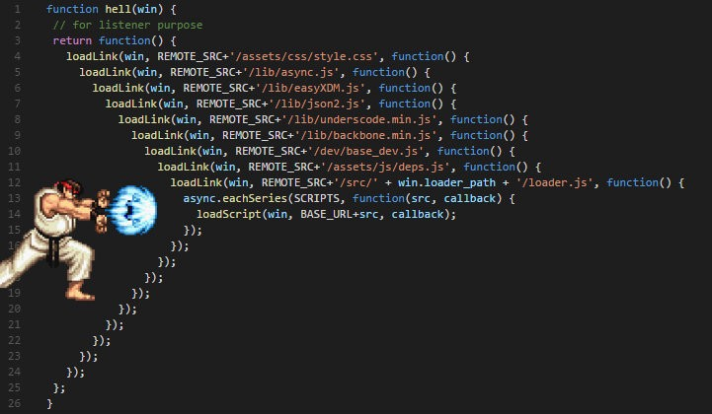
I/O IN JAVASCRIPT: CALLBACK HELL

Slide 48
I/O IN JAVA: REDUX
Classic I/O is generally easiest to use.
For most purposes, it works fine out-of-the-box.
However…
  For heavily I/O-bound programs, it sometimes needs some extra work with buffers and the like.
  For specialty programs with unusual I/O patterns (large-scale chat servers, P2P systems, etc.), nonblocking I/O sometimes works better.

